Slide 1
Ensemble

Slide 2
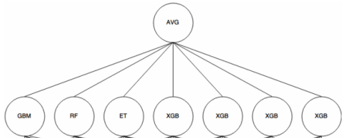
Ensemble
Ensemble approaches train several classifiers
Worst case scenario is better than the worse classifier
The combination rule: majority vote, mean, max, min, product

Slide 3
A pinch of maths
P of correctly finding
This majority vote ensemble will be correct an average of ~78% (0.3429 + 0.4409 = 0.7838).
A voting ensemble of 5 pseudo-random classifiers with 70% accuracy would be correct ~83% of the time.
All three are correct
0.7 * 0.7 * 0.7
= 0.3429
Two are correct
0.7 * 0.7 * 0.3
+ 0.7 * 0.3 * 0.7
+ 0.3 * 0.7 * 0.7
= 0.4409
Two are wrong
0.3 * 0.3 * 0.7
+ 0.3 * 0.7 * 0.3
+ 0.7 * 0.3 * 0.3
= 0.189
All three are wrong
0.3 * 0.3 * 0.3
= 0.027
Correct
Correct
wrong
wrong
https://mlwave.com/kaggle-ensembling-guide/

Slide 4
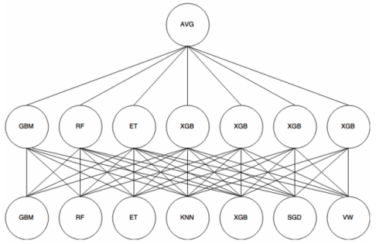
Blending and Stacking
Blending and stacking train a first layer of classifiers and use their outputs (i.e. probabilities) to train a second layer of classifiers
The final prediction is usually performed by the average rule or by a final base classifier (such as Logistic Regression in binary classification)
You can’t (or shouldn’t) use the training set itself to pass to the next layer
Stacking: using cross-fold-validation (the out-of-fold is used to train the next layer)
Blending: using a holdout validation (part of the train is used in the first layer, part in the second …)
A Python library for dynamic classifier and ensemble selection.
https://github.com/Menelau/DESlib

Slide 5
Ensembling
Ensemble approaches train several classifiers
Worst case scenario is better than the worse classifier
The combination rule: majority vote, mean, max, min, product

Slide 6
Ensembling

Slide 7
Ensembling

Slide 8
Ensembling

Slide 9
Ensembling

Slide 10
Ensembling

Slide 11
Ensembling

Slide 12
Ensembling

